Slide 1

CS325
Software Engineering

Slide 2
Motivation

Slide 3
The Reality of Code
Who here has written a program that perfectly solved a problem, but if you looked at the code 6 months later, you had absolutely no idea how it worked?
"
"
Computer Science taught you how to talk to the machine.
Software Engineering will teach you how to build systems for the real world.

Slide 4


The 60-Second Challenge
Your First Client Project
I am the CEO of a modern, high-tech startup. I am hiring this class to design a "Smart Door" for our new headquarters.
You have exactly 60 seconds.
▹
Write down the top 3 essential features.
▹
What sensors does it use?
▹
How does it integrate with our software?

Slide 5

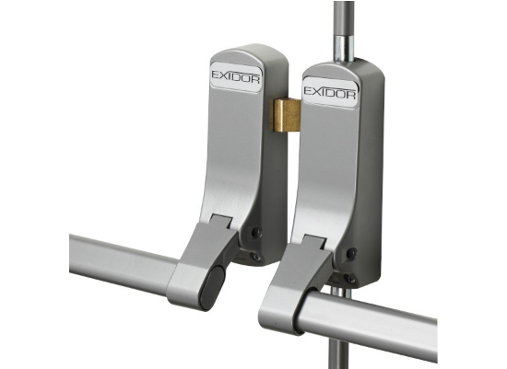
The Hidden Context
Project Failed.
I forgot to mention our startup manufactures highly volatile chemicals. The door you are designing is for the emergency fire exit.
▹
Must be 100% mechanical (No electronics/sparks).
▹
Must open outward instantly via a crash bar.
▹
You anchored your assumptions on the word "Smart".
Lesson: Never assume the context. If you don't elicit constraints, you write flawless code for the wrong system.

Slide 6
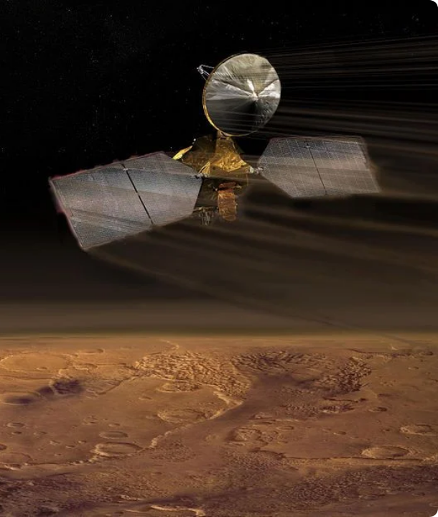
The $125M Disaster
09:04:52 UTC - Signal Lost
September 23, 1999. NASA is executing a critical, fully autonomous maneuver for the Mars Climate Orbiter.
The objective is to dip the probe into the Martian atmosphere to slow down and establish orbit. At exactly 09:04 UTC, the spacecraft goes behind Mars.
It was never heard from again. It burned up in the atmosphere. What was the root cause?

Slide 7



The Root Cause: A Unit Mismatch
Lockheed Martin
NASA JPL
Built the spacecraft and wrote the software calculating thruster data.
Wrote the navigation software that received the data to guide the probe.
Used English Units
(pound-seconds)
Used Metric Units
(newton-seconds)
The code executed its instructions perfectly. The math was flawless. The system still destroyed itself due to a failure in Requirements and Quality Assurance.

Slide 8









The Paradigm Shift
Time
Scale
People
A typical university project lives for 3 weeks. Enterprise software lives for decades. How do you design architecture that survives technological shifts?
A script runs on one laptop. A software system runs across distributed cloud servers handling thousands of concurrent user requests globally.
You aren't coding alone. You will read code written by someone who left years ago, and write code for someone you will never meet.

Slide 9
Course Expectations
Code is Not Enough A brilliant piece of code that is undocumented, untested, and ignores user requirements will fail in this class.
FYP Standards Apply Today The documentation and design standards you learn here are exactly what will be demanded of you in your Final Year Project.
Communication is Engineering You will work in teams. If you cannot explain your technical decisions to a non-technical stakeholder, the system will fail.

Slide 10
Questions?
Welcome to Software Engineering.

